Slide 1
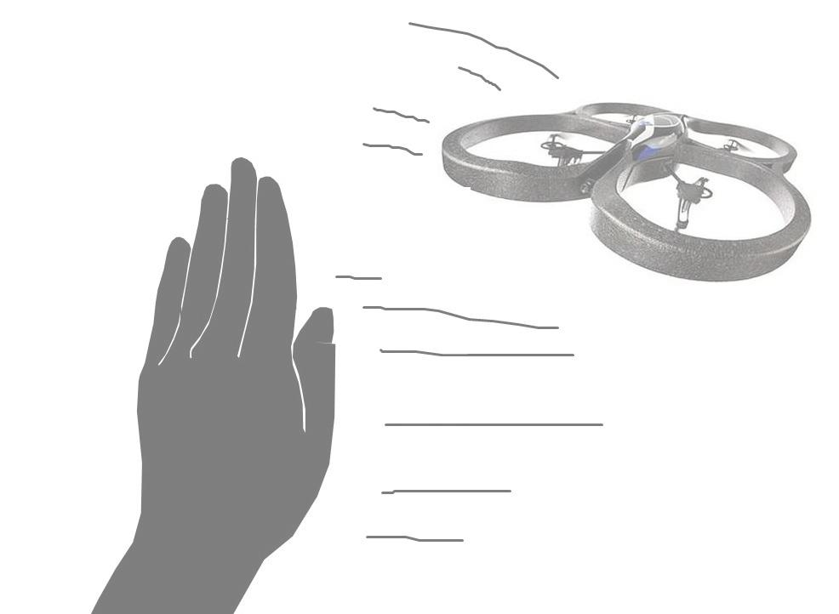
Simple Hand-Gesture Based Control of Quadcopters
Group 6
André S. Enger, Matthias Wisniowski, John Chiotellis

Slide 2

Successes and Failures
Detecting the hand with glove.
Derotation of quadrocopter roll.
Investigations on latency correction and forward distance estimation.
PID-controller.
Derotation of quadrocopter pitch.
Detecting the hand without glove.
Having the quadrocopter fly as desired.

Slide 3
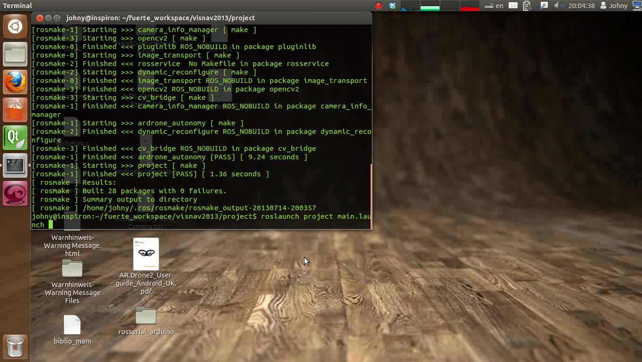
Demo (Hand Detection)

Slide 4
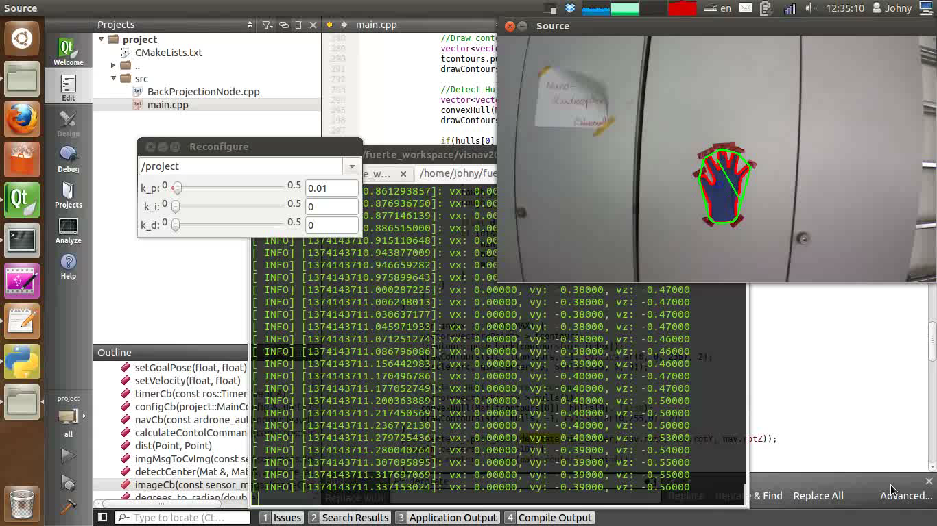
Demo (Controller)

